Slide 1

Google Play store Analysis
A Comprehensive Overview of the Mobile App Marketplace
Project:=>
Ankit sheoran
PGA46
31/08/2024

Slide 2
Title:
Project Overview
Content:
Objective : To analyze the Google Play Store ecosystem, including app categories, trends, ratings, and Install.
Scope:
Explore the different categories of apps available on the Play Store.
Identify key trends in app development and user preferences.
Analyze ratings, reviews, and their impact on app success.
Methodology:
Data collection from Github Google Play Store.
Analysis using SQL , Excel and data visualization with help of powerbi.
Visual Elements:
Icons or Graphics: Include relevant icons representing apps, data analysis, and trends. Using dashboard create attractive graphs and convert in simple way to understand
Infographic: Consider a simple infographic that illustrates the relationship between app categories, ratings, and downloads.

Slide 3
Analysis
App data
EXCEL
SQL

Slide 4

SQL analysis =>>
1. Calculates the average rating of all apps.
2. Finds the top 5 apps by number of installs.
3. Counts the number of free and paid apps.
4. Identifies the category with the most apps.
5. Sums the number of installs for all apps in the TOOLS category.

Slide 5



6. Compares the average rating between paid and free apps.
7. Counts apps with more than 1 million installs but fewer than 10 reviews.
8. Calculates the average size of apps in each category.
9. Finds apps last updated in 2018 with a rating above 4.5.
10. Finds the highest-rated app in the HEALTH_AND_FITNESS category.

Slide 6
Google Play Store Data Analysis Using SQL
Summary =>>
1. App Popularity and Installs
Categories with Most Installs: Categories like "GAME," "COMMUNICATION," and "TOOLS" dominate in terms of total installs, reflecting their essential role in users' daily mobile activities.
2. Ratings and User Reviews
Average Ratings: The average app rating hovers around 4.1, indicating generally positive feedback from users.
High Ratings, Low Reviews: Some apps with over 100,000 reviews still have ratings below 3.0, suggesting possible issues with app performance or user experience despite high engagement.
3. Free vs. Paid Apps
Dominance of Free Apps: A significant majority of apps are free, with free apps making up over 90% of the total. This trend aligns with the freemium model, where revenue is often generated through in-app purchases or ads.
Paid App Categories: Categories like "FAMILY" and "GAME" have more paid apps, indicating a market where users are willing to pay for quality or specialized content.
4. App Sizes and Requirements
Average App Size: The average app size is around 25MB, though this varies widely depending on the category, with games generally being larger due to rich media content.
Android Version Requirements: Most apps require Android 4.0.3 or higher, with some requiring the latest versions, reflecting developers' focus on supporting newer devices.

Slide 7
5. Pricing Trends
Most Expensive Apps: The most expensive apps can cost upwards of $100, typically found in specialized or professional categories.
Average Price of Paid Apps: The average price for paid apps is relatively low, often around $2 to $5, making them accessible to a broad audience.
6. Content Ratings and User Segmentation
Content Ratings: Most apps are rated "Everyone," indicating a broad target audience. However, categories like "GAME" also feature a substantial number of apps rated "Teen" or "Mature," targeting older users.
Family and Educational Apps: "FAMILY" apps often have content suitable for all ages, emphasizing educational and entertainment value for children.
Conclusion
The analysis of the Google Play Store dataset reveals key trends in app development, user preferences, and market dynamics. The data underscores the importance of offering quality content, maintaining regular updates, and understanding user needs across different app categories and genres. This information can be instrumental for developers, marketers, and stakeholders in the mobile app ecosystem.

Slide 8
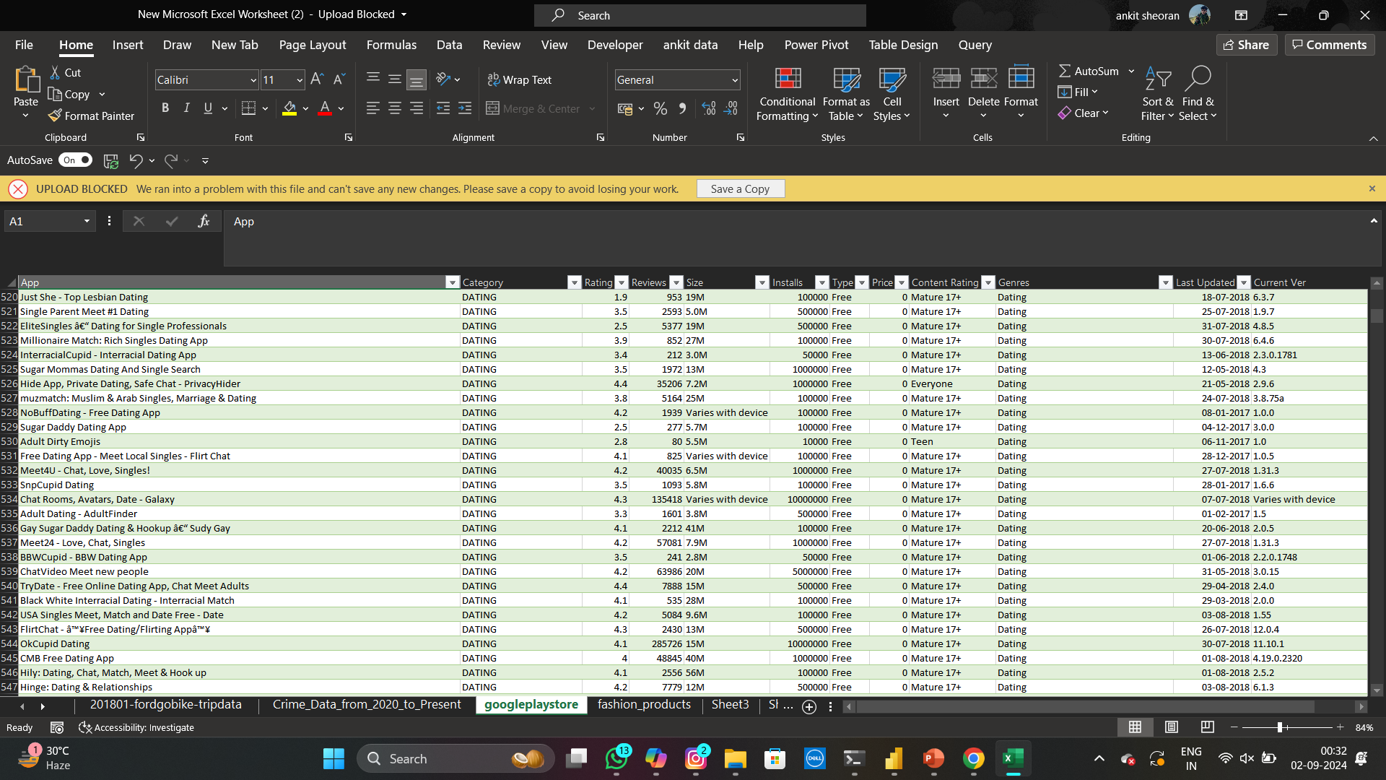
Excel analysis =>>
1. Importing the Data
Open Excel and use the "Import" feature to load the CSV file into Excel.
Data Cleaning: Ensure that columns like "Installs" and "Price" are cleaned by removing any non-numeric characters (like commas, dollar signs, etc.) to facilitate analysis.

Slide 9
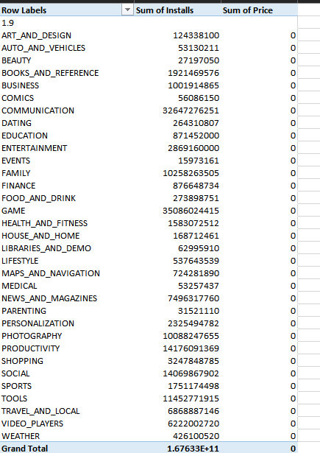
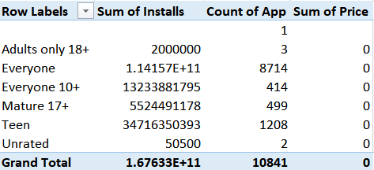
2. Analyzing the Data with Excel Tools
A. Using Pivot Tables
Top Installed Apps:
  Create a pivot table with "App" in the rows and "Installs" in the values. Sort by the sum of "Installs" to find the most installed apps.
Average Ratings by Category:
  Place "Category" in the rows and "Rating" in the values to calculate the average rating for each category.
Free vs. Paid Apps:
  Use "Type" in the rows and count of "App" in the values to compare the number of free and paid apps and sum of price .

Slide 10
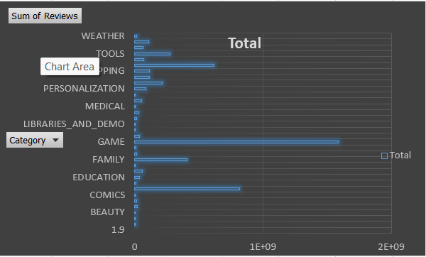
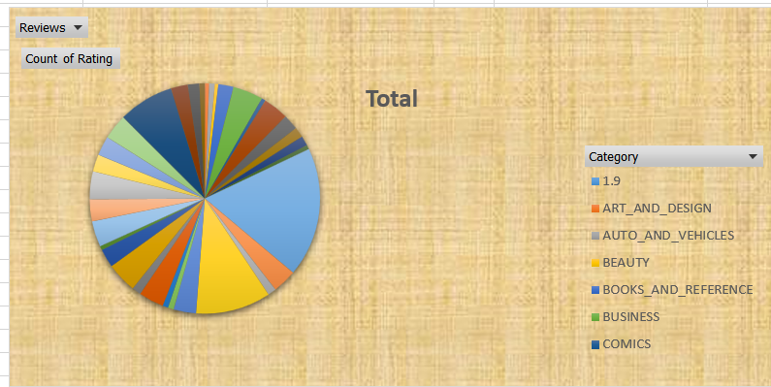
3. Creating Charts
Pie Chart for Content Rating Distribution:
  Create a pie chart based on a pivot table that counts of ratings for each “category".
Bar Chart for Most Popular Categories:
  Use a bar chart to visualize the category or sum of reviews across different categories.

Slide 11


4. VLOOKUP Example
Question:
How can you find the "Rating" of the app named "Instagram"?
Steps:
Assume your data is in columns A to E, with "App" in column A and "Rating" in column C.
Use VLOOKUP to search for "Instagram" in the "App" column and return the corresponding
5. HLOOKUP Example
Question:
How can you find the "Rating" of an app if the data is organized with categories listed horizontally (e.g., "App", "Category", "Rating", "Reviews" in Row 1) and app names in the subsequent rows?
Steps:
Assume your data is in rows 1 to 1000, with "App" names in column A and their corresponding "Rating" in column C.
Use HLOOKUP to search for "Rating" in the first row and find the rating for a specific app (e.g., in row 50).

Slide 12
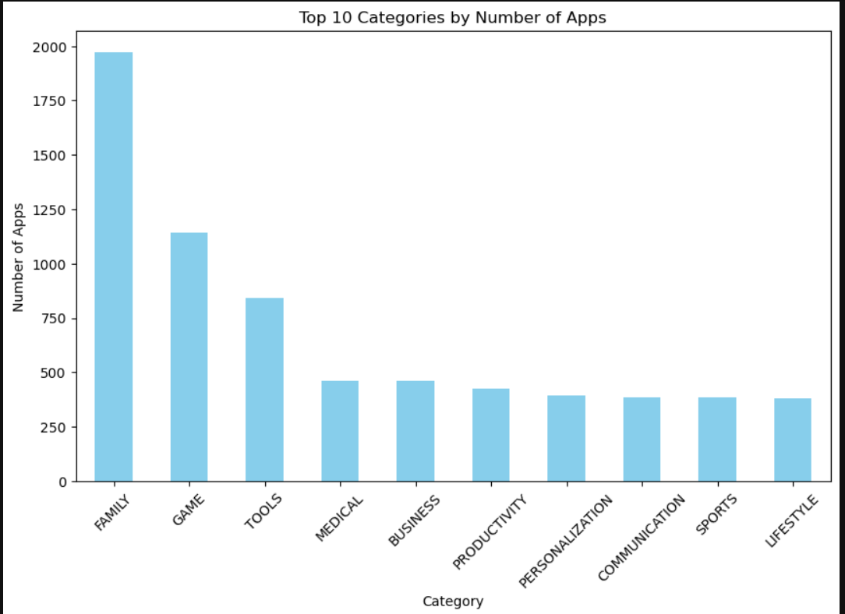
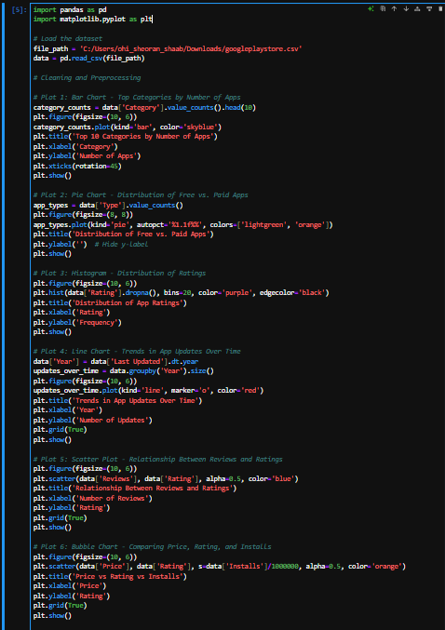
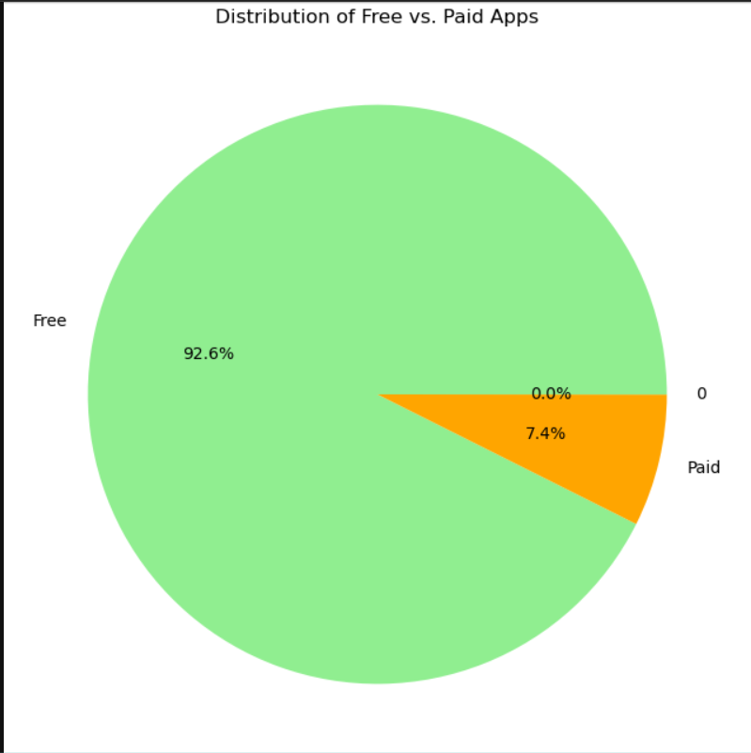
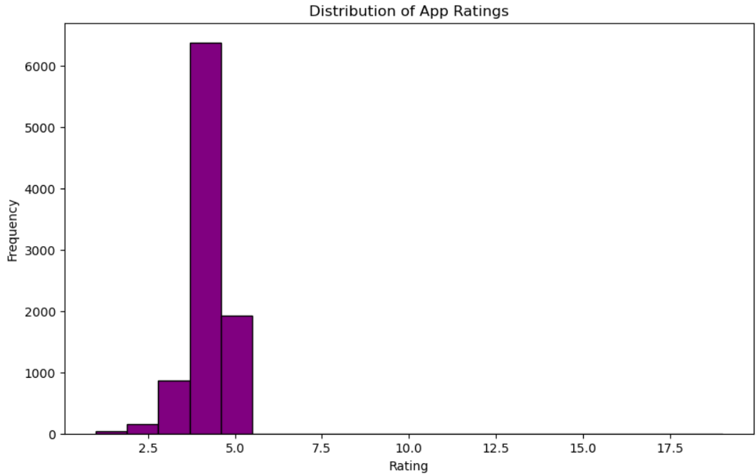
By using matplotlib =>>

